Slide 1
Unit Testing and JUnit
Prepared by Chala Urgessa

Slide 2
Outline
Unit Testing and JUnit
Assertion Methods
JUnit Best Practices
JUnit documentation
http://junit.org/junit5
https://junit.org/junit5/docs/snapshot/user-guide/

Slide 3
Unit Testing and JUnit

Slide 4
Unit Testing
Testing of an individual software unit
usually a class & its helpers
Focus on the functions of the unit
functionality, correctness, accuracy
Usually carried out by the developers of the unit
can use black-box and white-box techniques to design test cases

Slide 5
Unit Testing
Unit testing: Looking for errors in a subsystem in isolation.
Generally a "subsystem" means a particular class or object.
The Java library JUnit helps us to easily perform unit testing.
The basic idea:
For a given class Foo, create another class FooTest to test it, containing various "test case" methods to run.
Each method looks for particular results and passes / fails.
JUnit provides "assert" commands to help us write tests.
The idea: Put assertion calls in your test methods to check things you expect to be true. If they aren't, the test will fail.

Slide 6
Why JUnit
Allows you to write code faster while increasing quality
Elegantly simple
Check their own results and provide immediate feedback
Tests are inexpensive
Increase the stability of software
Developer tests
Written in Java
Free
Gives proper understanding of unit testing

Slide 7
JUnit
JUnit helps the programmer:
Define and execute tests and test suites
Formalize requirements and clarify architecture
Write and debug code
Integrate code and always be ready to release a working version
What JUnit does
JUnit runs a suite of tests and reports results

Slide 8
JUnit
JUnit is a framework for writing unit tests
A unit test is a test of a single class
A test case is a single test of a single method
A test suite is a collection of test cases
Unit testing is particularly important when software requirements change frequently
Code often has to be refactored to incorporate the changes
Unit testing helps ensure that the refactored code continues to work

Slide 9
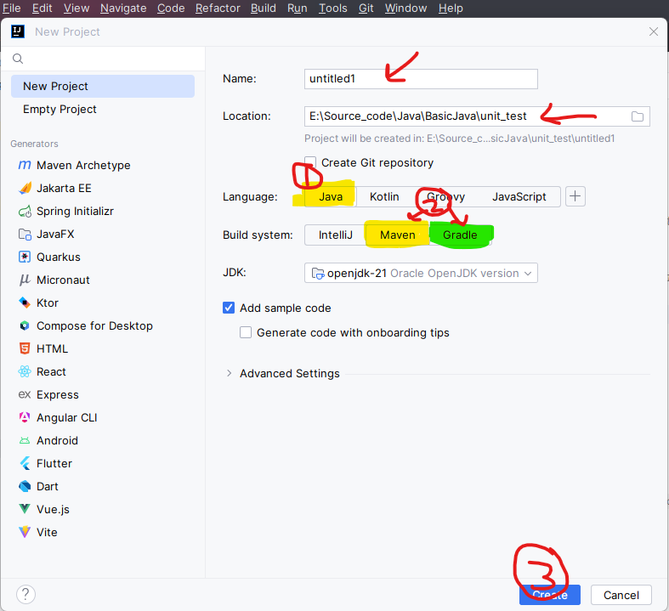
Adding JUnit Dependency
Adding JUnit dependency via Maven/Gradle
For Maven
Step 1: Open `pom.xml`
Step 2: Add Junit dependency to `<dependencies>` section:
Step 3: Save and allow Maven to synchronize the project.
For Gradle
Step 1: Open build.gradle.
Step 2: Add JUnit dependency to dependencies block:
Step 3: Save and let Gradle sync the project.
<dependency> <groupId>org.junit.jupiter</groupId> <artifactId>junit-jupiter-api</artifactId> <version>5.7.0</version> <scope>test</scope> </dependency>
testImplementation 'org.junit.jupiter:junit-jupiter-api:5.7.0'
Notes:
Maven: Uses a convention-over-configuration approach. It offers a highly structured and standardized build process, relying on an XML file (pom.xml) for project configuration.
Gradle: Emphasizes flexibility and performance. It uses a Groovy-based DSL (Domain-Specific Language) for configuration, moving away from XML to a more expressive and concise way of describing build scripts.

Slide 10
Imported Packages
Your JUnit test classes should have the following import declarations:
import static org.junit.jupiter.api.Assertions.*; import org.junit.jupiter.api.Test;
The keyword static makes it so that instead of having to write org.junit.jupiter.Assertions.assertTrue(...), you can
just write assertTrue(...).
If you are creating a test suite, the imports that are needed are different (see slides for test suites).

Slide 11
A JUnit test class
import static org.junit.jupiter.api.Assertions.*;
import org.junit.jupiter.api.Test;
class name {
...
@Test
public void basicTest() { // a test case method
assertTrue(true, “true is true”);
...
}
}
A method with @Test is flagged as a JUnit test case.
All @Test methods run when JUnit runs your test class.

Slide 12
The structure of a test method
A test method doesn’t return a result
If the tests run correctly, a test method does nothing
If a test fails, it throws an AssertionFailedError
The JUnit framework catches the error and deals with it; you don’t have to do anything

Slide 13
Test suites
In practice, you want to run a group of related tests (e.g. all the tests for a class)
To do so, group your test methods in a class with annotations @SelectPackages or @SelectClasses

Slide 14
Organize The Tests
Create test cases in the same package as the code under test
For each Java package in your application, define a TestSuite class that contains all the tests for validating the code in the package
Define similar TestSuite classes that create higher-level and lower-level test suites in the other packages (and sub-packages) of the application
Make sure your build process include the compilation of all tests

Slide 15
JUnit Best Practices
Separate production and test code
But typically in the same packages
Compile into separate trees, allowing deployment without tests
Don’t forget OO techniques, base classing
Test-driven development
Write failing test first
Write enough code to pass
Refactor
Run tests again
Repeat until software meets goal
Write new code only when test is failing

Slide 16
JUnit Best Practices
Tests need failure atomically (ability to know exactly what failed).
Each test should have a clear, long, descriptive name.
Assertions should always have clear messages to know what failed.
Write many small tests, not one big test.
Each test should have roughly just 1 assertion at its end.
Test for expected errors / exceptions.
Choose a descriptive assert method, not always assertTrue.
Choose representative test cases from equivalent input classes.
Avoid complex logic in test methods if possible.

Slide 17
Problems with unit testing
JUnit is designed to call methods and compare the results they return against expected results
This ignores:
Programs that do work in response to GUI commands
Methods that are used primarily to produce output
Heavy use of JUnit encourages a “functional” style, where most methods are called to compute a value, rather than to have side effects
This can actually be a good thing
Methods that just return results, without side effects (such as printing), are simpler, more general, and easier to reuse

